Slide 1
Trading systems design
Securities master database, automated trading systems, and reporting

Slide 2
System Design
AlphaVantage
Fidelity
dailyupdates.py
Daily performance, positions, transactions
Pylivetrader_mod
Paper strategies (testing)
Live strategies
SMDB
Trading Strategy Logic
Data
Viable strategies
dailyreport.py
Research & Development
dailyreport.py
Reporting
Concept
Statistical Validation
Backtesting & Walkforward Analysis
Monte Carlo Analysis

Slide 3
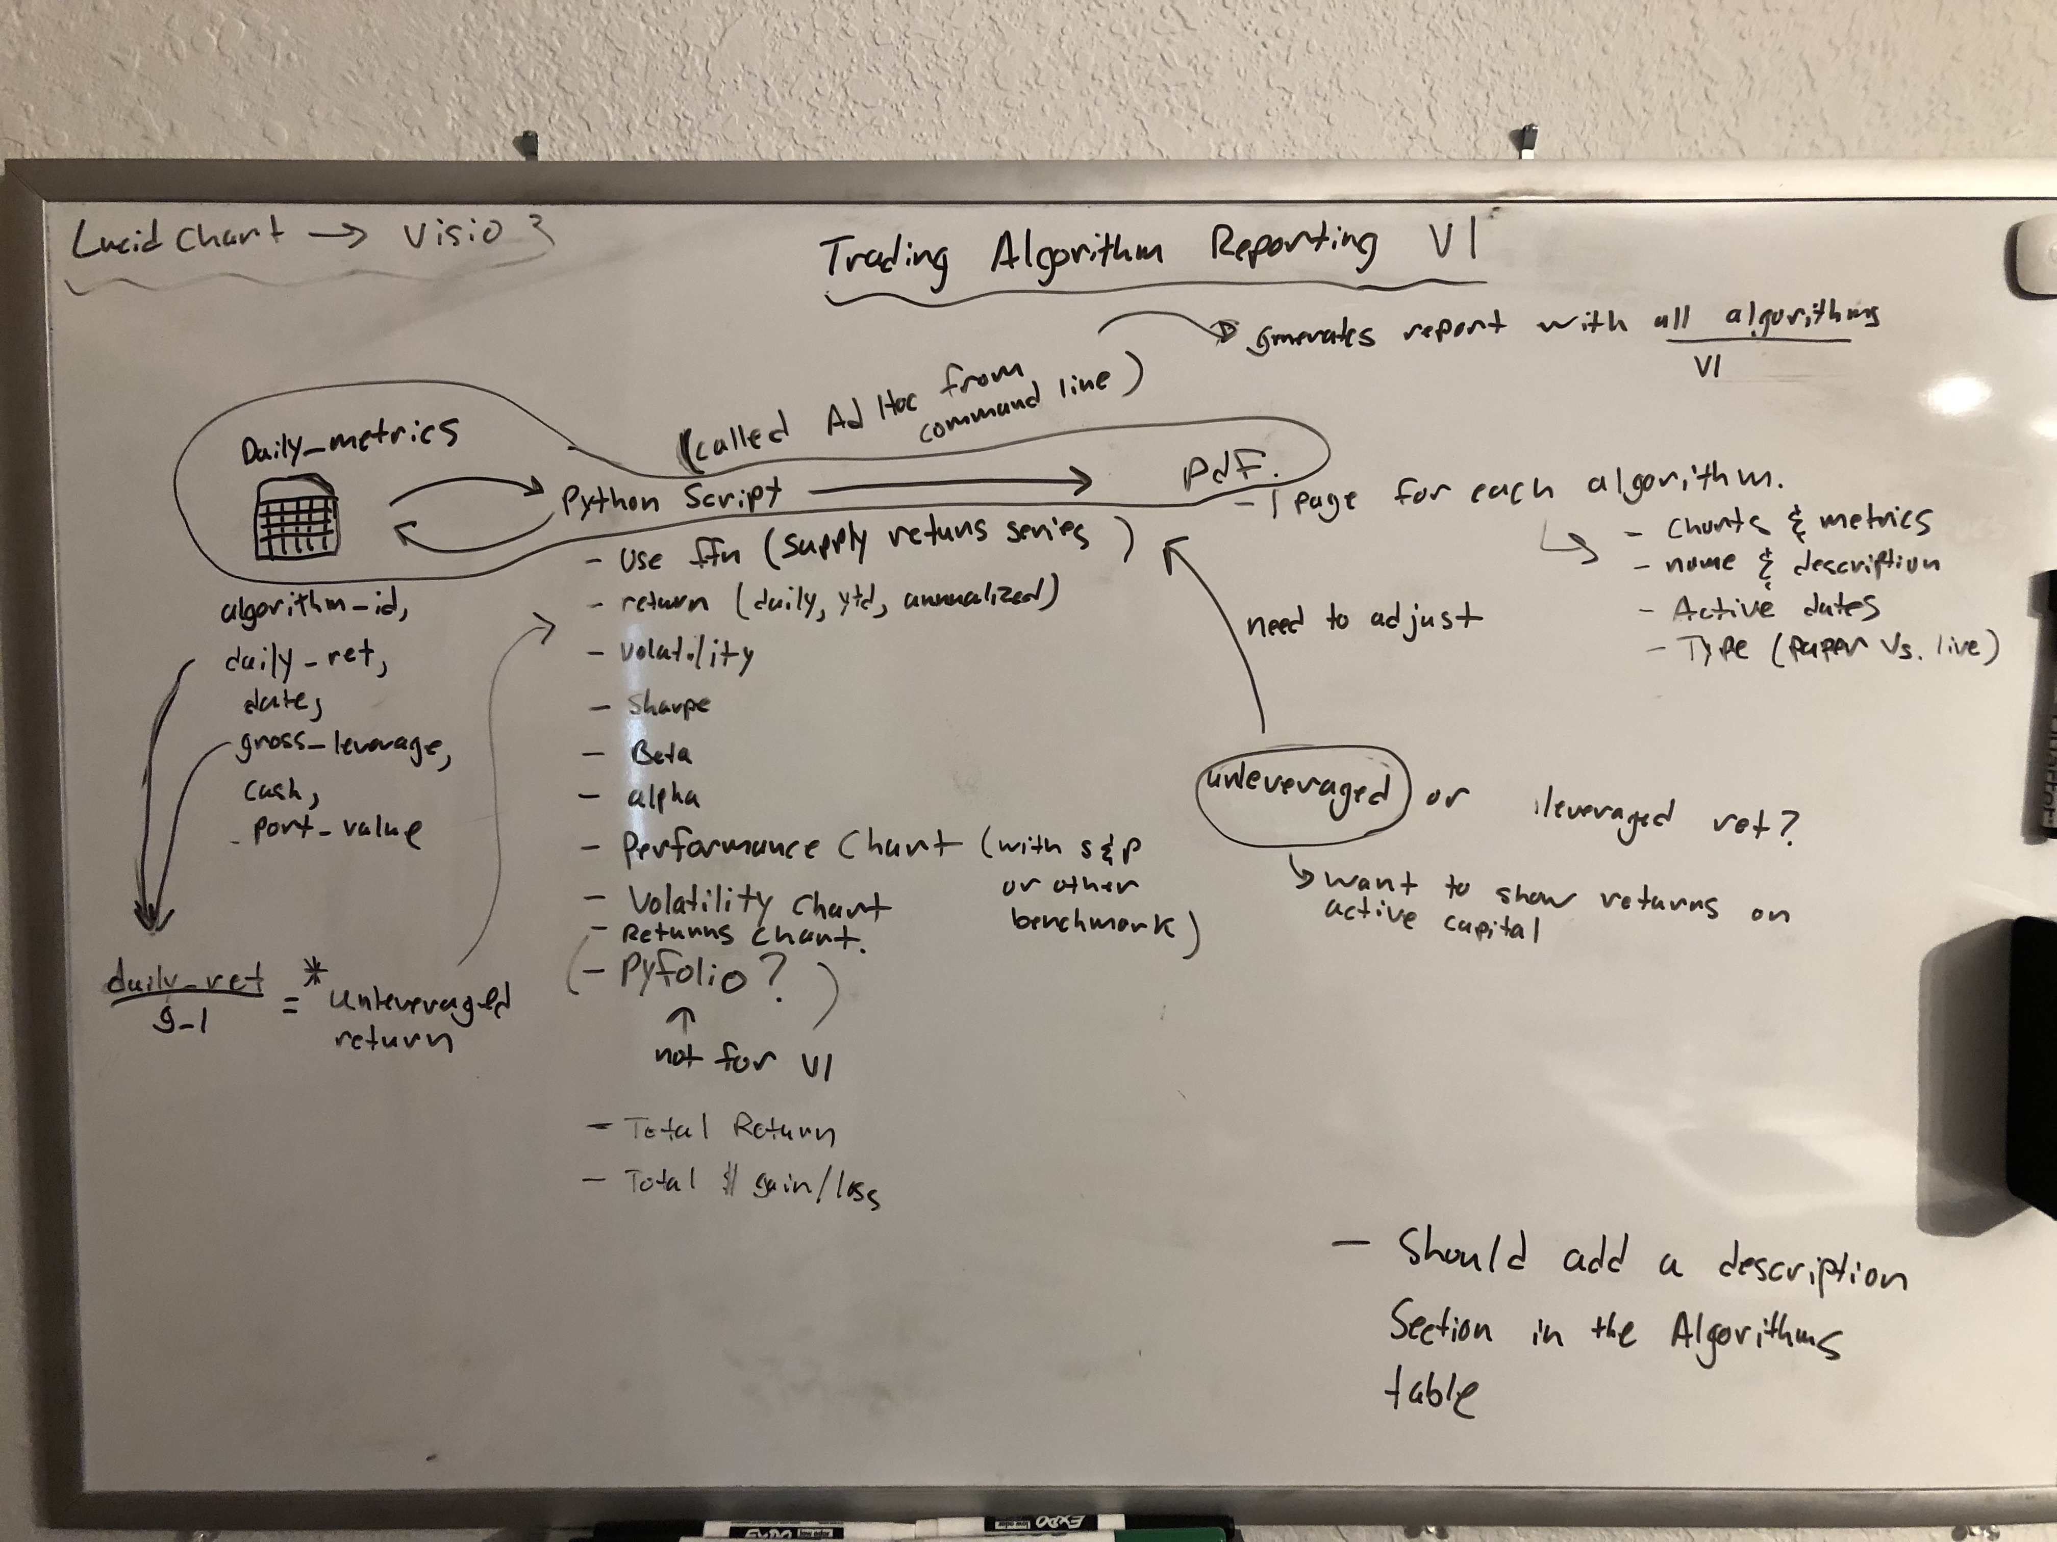
Reporting

Slide 4
Reporting
Metrics (return, leverage, etc.) are written into the SMDB daily.
Every day, a scheduled script is run to do analysis on trading algorithm performance and the results are written to a new excel file in a dedicated location.
Script is written in python, and tools such as ffn are used to calculate financial metrics. Openpyxl is used to create the excel workbooks.
Script also fetches latest Etrade performance and writes to the same Excel report.
Script is scheduled locally using launchctl and a plist. The script will run everyday at 6PM PST.

